Slide 1
School Self-evaluation: Next Steps 2022-2026 is built around five key considerations:
The impact of COVID-19
The focus of SSE
The SSE process
Participation in SSE
Supports for SSE

Slide 2
In rebooting or continuing their SSE processes, schools need to identify and reflect
on the impact of COVID-19 on pupils’/students’ educational experiences and outcomes,
their wellbeing,
their motivation to learn, and their engagement in learning.
Balancing school and system requirements

Slide 3
SSE is supported by a quality framework, Looking at Our School (LAOS) 2022, which provides a set of criteria or descriptors of quality in schools.
The statements of practice are the key to making judgements about how effective aspects of provision are and to supporting a school in deciding what needs to be done in order to improve.

Slide 4
Key elements of a supportive SSE culture include:
Ongoing reflection at an individual teacher and collective staff level
Teacher professionalism
Sharing of classroom practice
Authentic assessment
Developmental classroom observation
Professional feedback and peer learning.

Slide 5
Identify focus
Gather evidence
Analyse
Write and share report
Put plan into action
Monitor actions and evaluate
School Self Evaluation

Slide 6


Slide 7




School Improvement Plan
Impact of COVID
Teaching and Learning
Inclusive Classroom
Classroom Management
Junior Dún
Connect Time
Theme Weeks
Wellbeing
Active and Responsible
Relationships
Curriculum
Culture
Policy and Planning
Core Wellbeing Team:
CSPE, PE and SPHE
Improve Physical Environment
Homework Policy
Anti Bullying Policy
Empower Voices
Students , Parents and Teachers
Code of Behaviour
Growth Mindset
Teaching and Learning Policy
School Self Evaluation

Slide 8


Promote the Learning Process
Learning Intentions
Success Criteria
Effective Questioning
Bloom’s Taxonomy
Student Reflection
Teacher Collaboration
Coaching
Mentoring
Peer Observation
Student Leadership
“Leading Learners”
Digital Literacy and Pedagogy
Teaching and Learning
Literacy and Numeracy Revisited
Sustainable Education

Slide 9
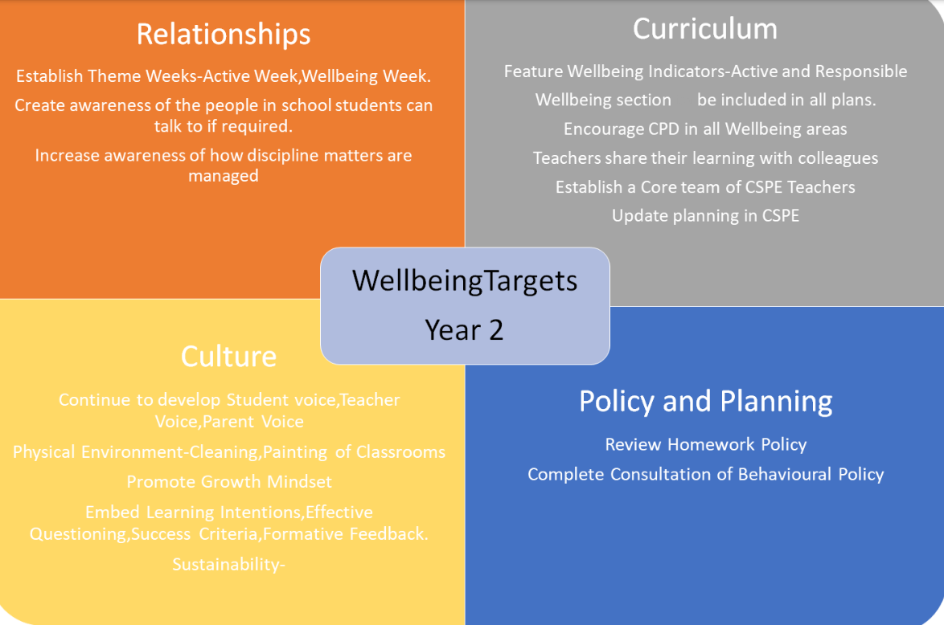

Slide 10


Slide 11
PHASE ONE

Slide 12
Our School Improvement plan will be centered around the wellbeing – Relationships/ Culture/Curriculum/ Policy and Planning.
School Values and Ethos
The staff evaluated areas that needed improvement during a school planning day and the following targets were suggested

Slide 13
Set 1 target for positive classroom management Actions to achieve this target Set 1 target to foster a positive school identity Actions | Set 1 target to improve your use of the “the Learning Process” Actions Set 1 target to increase Teacher collaboration Actions
Set 1 target to improve the physical learning environment Actions Set 1 target to promote student voice in the classroom Actions
Wellbeing
Relationships
Curriculum
Culture
Policy and Planning
Set 1 target in relation to reviewing the Homework Policy
Actions
Set 1 target in relation Attendance and participation strategy
Actions
Names:

Slide 14
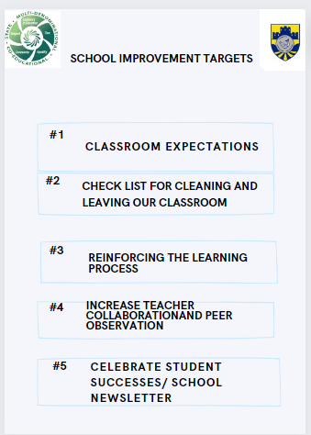
School Improvement Targets

Slide 15
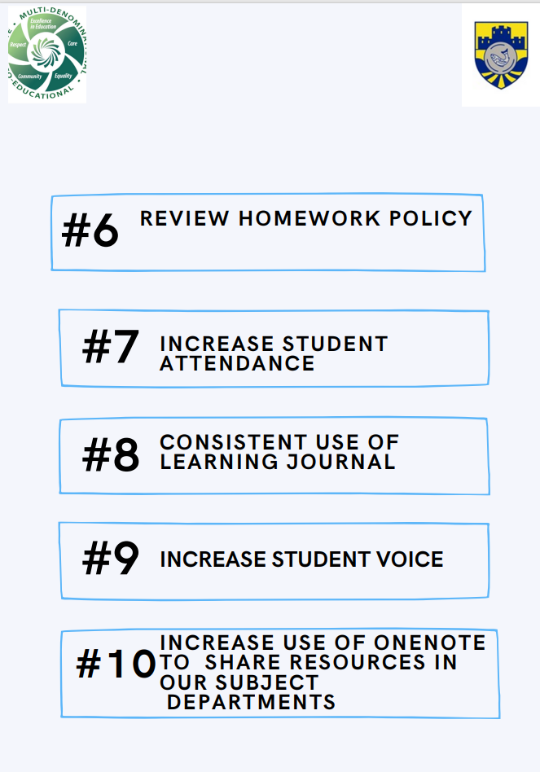
School Improvement Targets

Slide 16
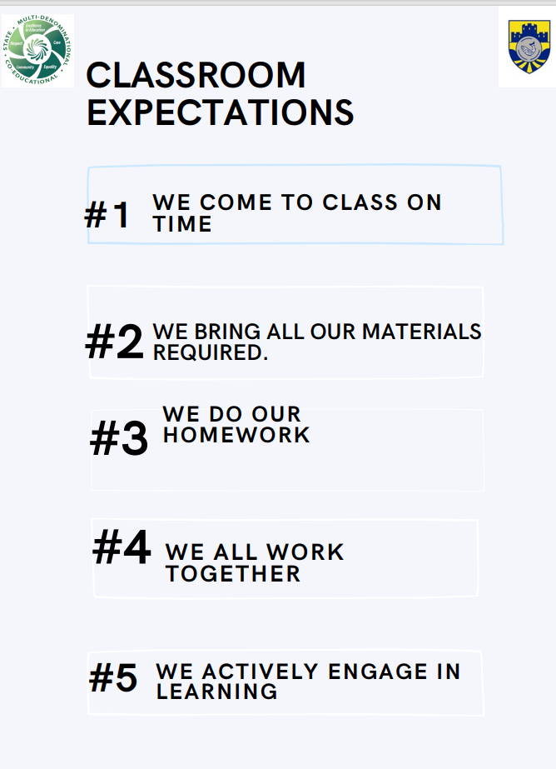
Target One- Classroom Management
Expectations created by Classroom Management Team and will be used in all our “Classroom Expectations”

Slide 17
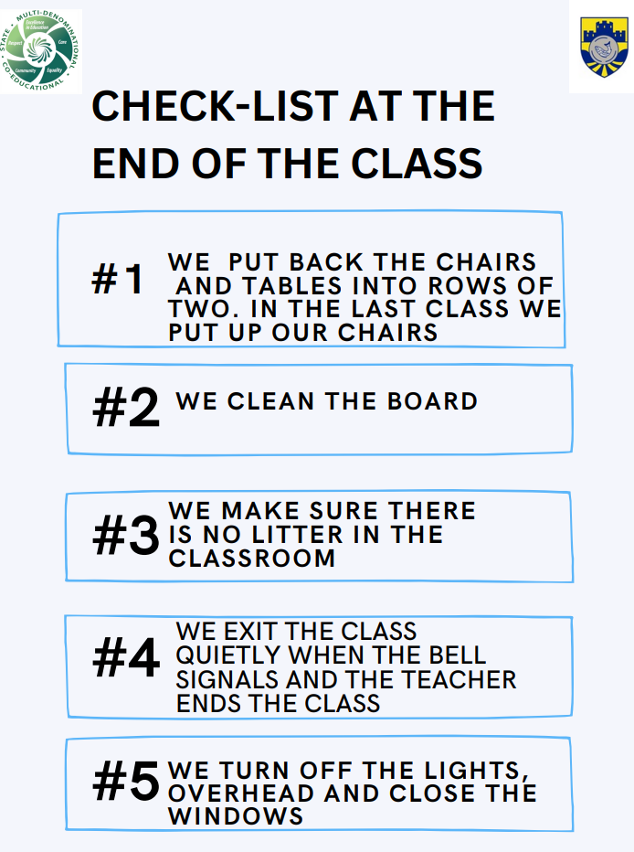
Target Two – Respect our School Environment
Checklist placed in each classroom and to be followed by each class

Slide 18
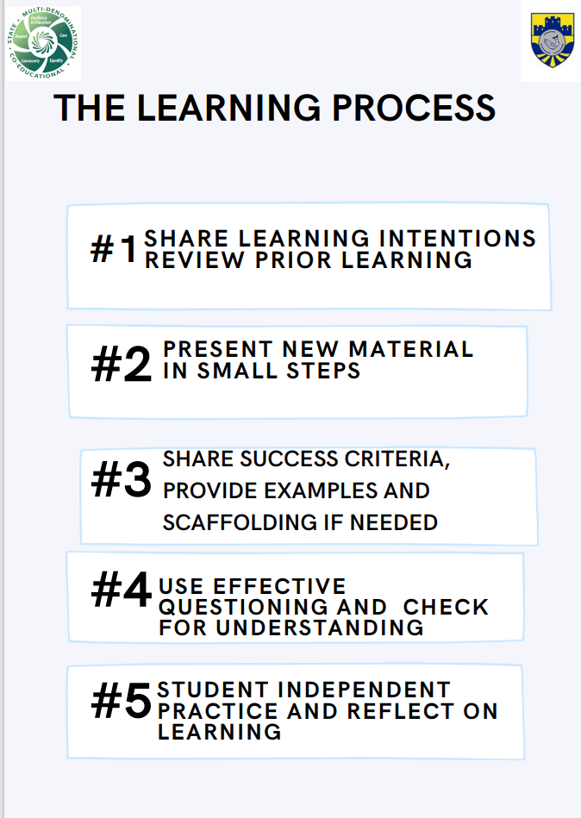
Target Three: Using research to reinforce the Learning Process- Rosenshine’s Principles of Instruction- Headings to be placed on white board in each classroom.

Slide 19

Target Five:
School Newsletter- will be published each term and shared with the school community to share and celebrate our successes.

Slide 20
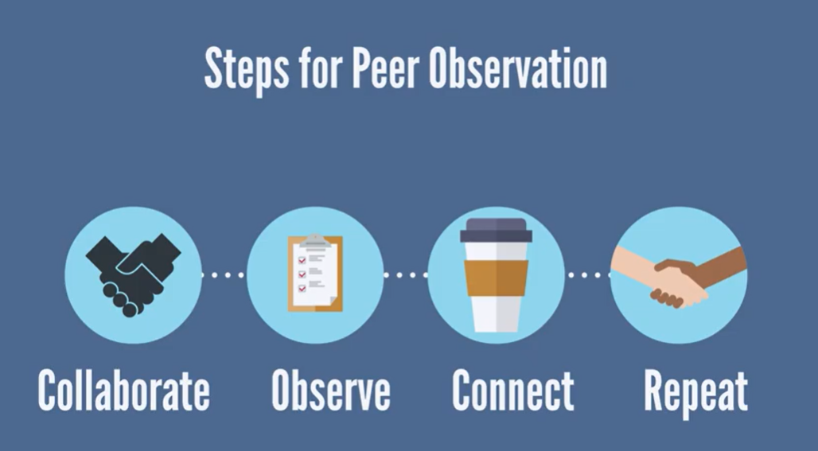

Target Four:
TEACHER
COLLABORATION
Teachers interested will be given training in Coaching and Peer Observation. Two teachers will then be paired together. Each teacher will be asked to complete two observations of another teacher during the year. We decided to start small and informal with no recording of observations, no constructive criticism, simply recording the observation date. Our vision for the next few years is to grow and develop the process hopefully to a point where it is an integral part of or school culture
This Photo by Unknown Author is licensed under CC BY-NC

Slide 21
Target Six
: Review Policies
Homework Policy Committee will be set up to review Homework and Study Policy. Through collaboration and consultation with the following partners and interested parties:
The Staff of the College
The Parents' Association of the College.
The Students of the College.

Slide 22
TARGET SEVEN-INCREASE STUDENT ATTENDANCE BY 3 %
Foster an appreciation of learning by having good attendance practices-Use VSware to track attendance
To comply with requirements under Education Welfare Act 2000- Attendance reports
To raise awareness of importance of school attendance- Assemblies and Connect Time
To identify pupils at risk of school leaving early - Attendance Coordinator
To enhance the learning environment where children can make progress in all aspects of their development – Target setting/ Extra curricular

Slide 23
Each student must have there Learning Journal in every class. Students are asked to record all aspects of homework for every subject-
Journals will be checked in Connect Time
Time is given during class to record assigned work. Journals are not private to students and act as a link between parents / guardians and teachers.
Homework is corrected regularly and in a timely fashion.
Students are encouraged to track their progress in subjects in their School Journal.
SEN:
The SEN Department assists SEN students.
Junior Dún students attend Homework session
Homework and Study Skills workshops will be provided to students.
Evening study for all years available
Saturday and periodic holiday study sessions available for sixth years
Target Eight
Consistent use of “School Learning Journal” to support learning.

Slide 24
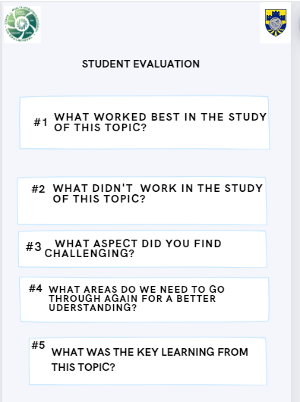
TARGET NINE
Student Voice – Create evaluation sheet to be used in each subject to inform our Teaching and Learning

Slide 25

Target Ten- To Increase use of OneNote
Target Ten: Increase the use of One Note in our Classroom teaching and Planning
To Increase the use of One Note for Planning and Sharing of Resources
More Training in Using OneNote- workshops
Departments using OneNote to share experience with other Departments

Slide 26
Staff Meeting 9th May 2023
SSE Objectives 2023-2026
Incremental improvement in student engagement with learning
Incremental improvement in student/staff wellbeing and connection with school community

